Slide 1

AZURE HACKATHON
Banking and Finance

Slide 2

OUR BIG IDEA
Our mission is to enable financial stability for banks and SMEs through holistic, heuristic and efficient credit risk analysis. We aim to build financial trust and transparency among lenders and borrowers.

Slide 3



OBJECTIVES
Identify accounts by industry sector which have highest probability of turning to non-performing account.
Will economic slowdown increase the probability of default for mid-sized corporations and SMEs?
Identify distressed industry sectors by location.
Will there be a difference in impact in industries in different locations?
Is there a correlation between the government policies and the probability of default of SMEs?
Identify key determinants which may impact companies' financial health.
What could be the necessary precautions / capital provisions for adverse impact handling?

Slide 4
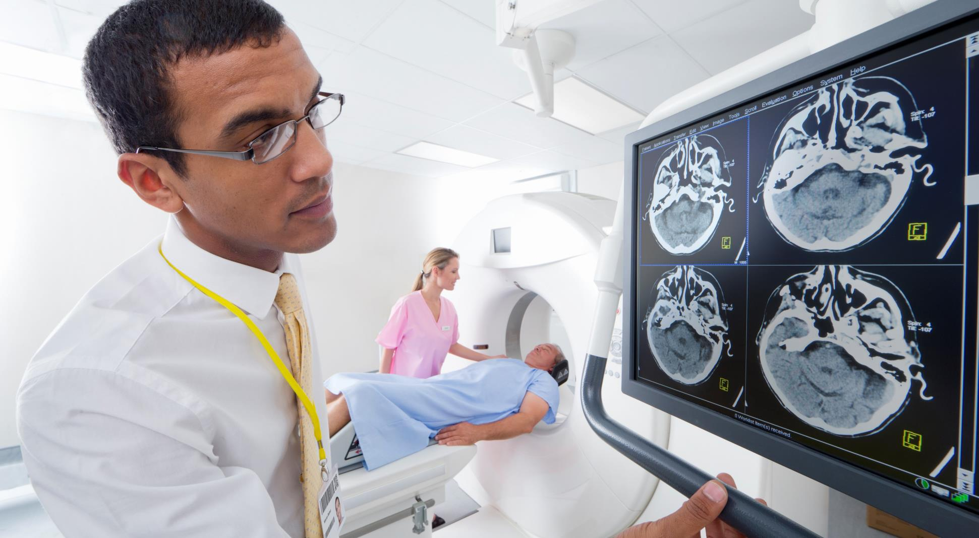





INDUSTRY OUTLOOK
250T USD
8,150B USD
1.9
7%
50%
Total Debt in early 2019.
Financial Debt across Europe, US, Canada, Asia-Pacific and Africa in Sept 2019.
All time high non-performing loan ratio.
Of loans in 81% of banking crisis.
Of total loans are NPL
What will be the outlook post Covid-19?

Slide 5



DATA SOURCES
Open source Datasets
Market Data
Banks In house Data
Covid Impact Data https://github.com/owid/covid-19-data
https://www.worldometers.info/coronavirus/
Macro Economic Indicators by Countries- https://tradingeconomics.com/countries
UN Population trends as an indicator of distressed industries - https://www.un.org/development/desa/en/news/population/2018-revision-of-world-urbanization-prospects.html
Distressed Sector/Industry Trends by Region and by time period
https://tradingeconomics.com/united-states/crude-oil-production
OECD Main Economic Indicators
Local economic considerations
Loans and Defaults of Borrower SME
Expenses and Revenues of the SME
Impact on P&L of Mergers and Acquisitions
SMEs Competitors health (SMEs from same industry)
Marketing budgets, share of fixed and variable costs.

Slide 6







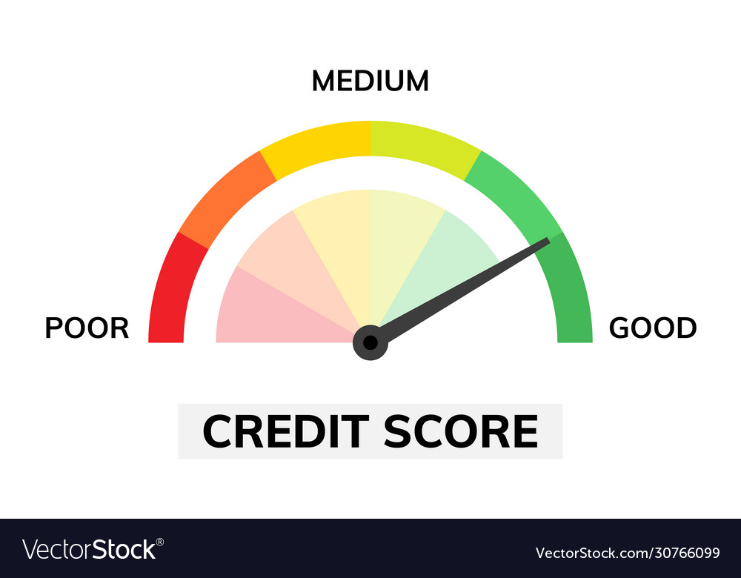








Azure Architecture
On-premise/ Cloud
Azure Container Registry
Azure Kubernetes Service
Azure Machine Learning
Banks Data Sources (DB, Scanned Forms, PDFs, Excel etc.)
PDFs, Scanned Form extraction using Form Extractor
Web Apps
End User
Model Performance and Application Logs saved in SQL DB
Access to Credit Scores
Data Extraction and Orchestration using Data Factory
Storing structured and unstructured data in Cosmos DB
External Data Sources
Azure SQL Database
Dashboards for Model Performance, Application Logs
Macroeconomic Factors
Twitter sentiment analysis using cognitive services
Covid risk trend
Twitter Sentiment Data

Slide 7
How Banks Will Use Our Solution
Since customer data is sensitive for banks and is not publicly available, as an end product we will deliver configurable framework and models which can directly be integrated with banks internal databases.
The solution will be made available as a user friendly web app, which will provide below functionalities:
Business Insights:
Insights on distressed industry sector for selected location.
Macroeconomic factors and their outlook contributing to the distressed industry sector.
Probability of a selected account turning NPA, and recommendations based on industry outlook.
Technical Insights:
Performance of different machine learning models which determine the probability of an account turning NPA.
Key factors impacting the machine learning models.
Training schedule and jobs status of different models.

Slide 8
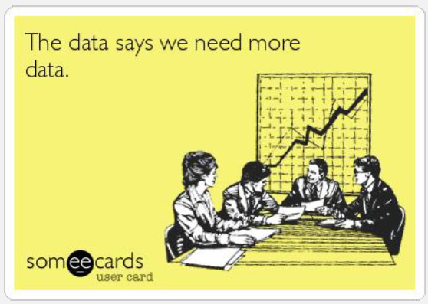
What does the data say?
https://www.kaggle.com/gauravduttakiit/loan-defaulter
Loan Defaulter dataset
~9% defaults present
Assumptions: The dataset is available on account level. We have assumed the accounts to be SME accounts.

Slide 9

Results

Slide 10
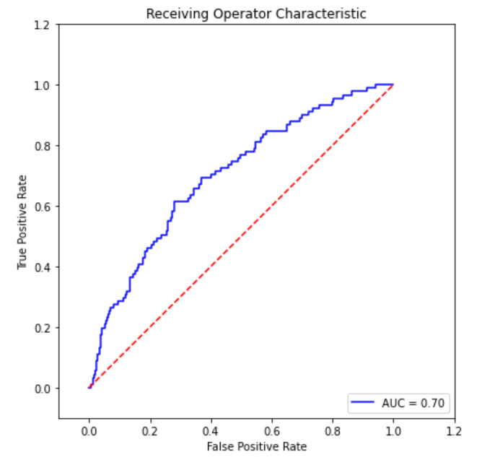
Findings
70% of the times model can distinguish between a default SME and a non-default SME.
90% of the times the model will predict accurately if the SME will default in future.
Out of those, the model will precisely predict 55% defaulters correctly.
Note: The model currently is independent of macro-economic indicators.

Slide 11
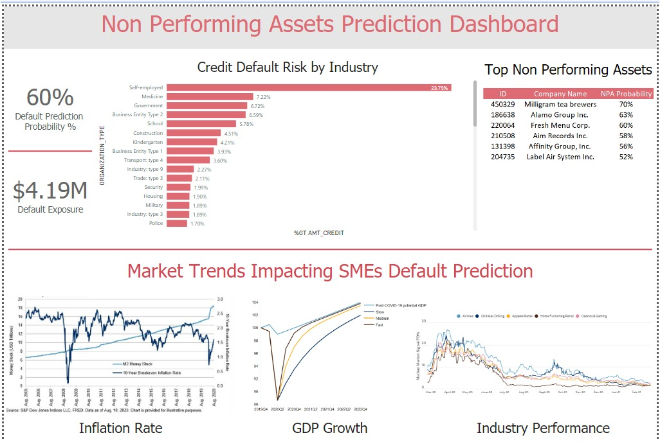
The Dashboard
Overall Default Probability
Highlights at-risk Clients
Maximum Predicted Default
Industry Overview
Market Trend Information

Slide 12



Next Steps
Live Environment
Alternate Data
User Acceptance
Test out the Algorithm in live environment to evaluate model performance.
Do UAT to better model learning.
Use Sentiment Analysis from news reports for Social Listening.
Inspect Brand Health for “Watch SMEs”
Collect feedback on functionality by the end user.

Slide 13



Shark Tank Pitch
Configurable Framework
Early Warning Triggers
Global, Local and Social
A framework customized to the bank’s infrastructure.
Train end-users in using the framework and drawing insights from the it.
Create an industry standard.
“Watch SMEs” can be closely monitored for any early warning signs.
Early Warning Recommendations for deteriorating “Watch SMEs”
Macro economic indicators globally and locally closely monitored.
Regional and International trends help predict default probability with higher accuracy.
Monitors cyber space for health activity.

Slide 14




THE TEAM
The Team
Akanksha Sharma
Gurkiran Kaur
Data Analyst - FinTech
Data Scientist - Banking and Finance
Prateek Nagaria
Sakshi Khatri
Data Science Manager
Data Analyst - Banking Expert

Slide 15
References
https://www.researchgate.net/publication/266210869_A_Statistical_Analysis_to_Predict_Financial_Distress
https://www.spglobal.com/marketintelligence/en/news-insights/blog/industries-most-and-least-impacted-by-covid19-from-a-probability-of-default-perspective-september-2020-update
https://www.spglobal.com/marketintelligence/en/news-insights/blog/alternative-approaches-for-assessing-credit-risk-using-consensus-estimates
https://www.statista.com/statistics/1106302/coronavirus-impact-index-by-industry-2020/

Slide 16
Top Impacted Sectors
As per market research top 5 impacted sectors are:
Top 5 Impacted Sectors | Least 5 Impacted Sectors
Airlines | Specialized REITs
Leisure Facilities | Property & Casualty Insurance
Oil & Gas Drilling | Multi-line Insurance
Auto Parts and Equipment | Life & Health Insurance
Restaurants | Industrial REITs

